Slide 1
Hospital diagnostics using image classification and portal
BY TROJAN HORSES
https://unsuccessive-jeopar.000webhostapp.com : DEPLOYED DYNAMICALLY

Slide 2
Table of contents
Abstract
Model abstract:
System Requirements:
System Architecture:
Database Design:
Features and Functionality:
Implementation:
User Interface:
Machine language model for image processing
Future Enhancements:
Conclusion:

Slide 3
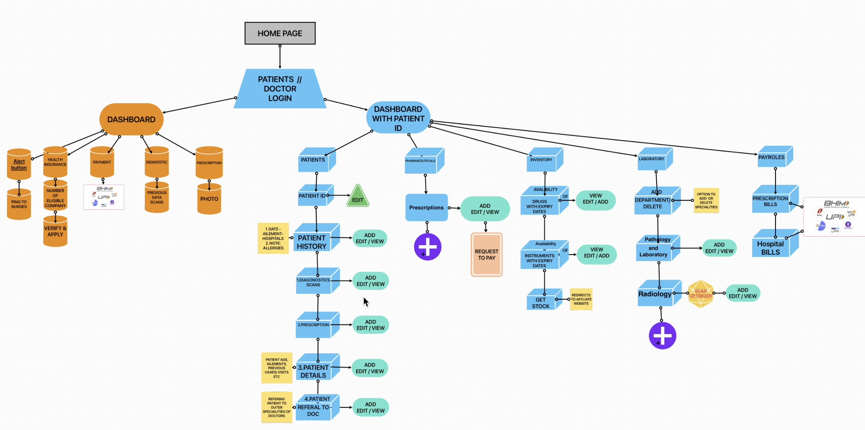

Slide 4
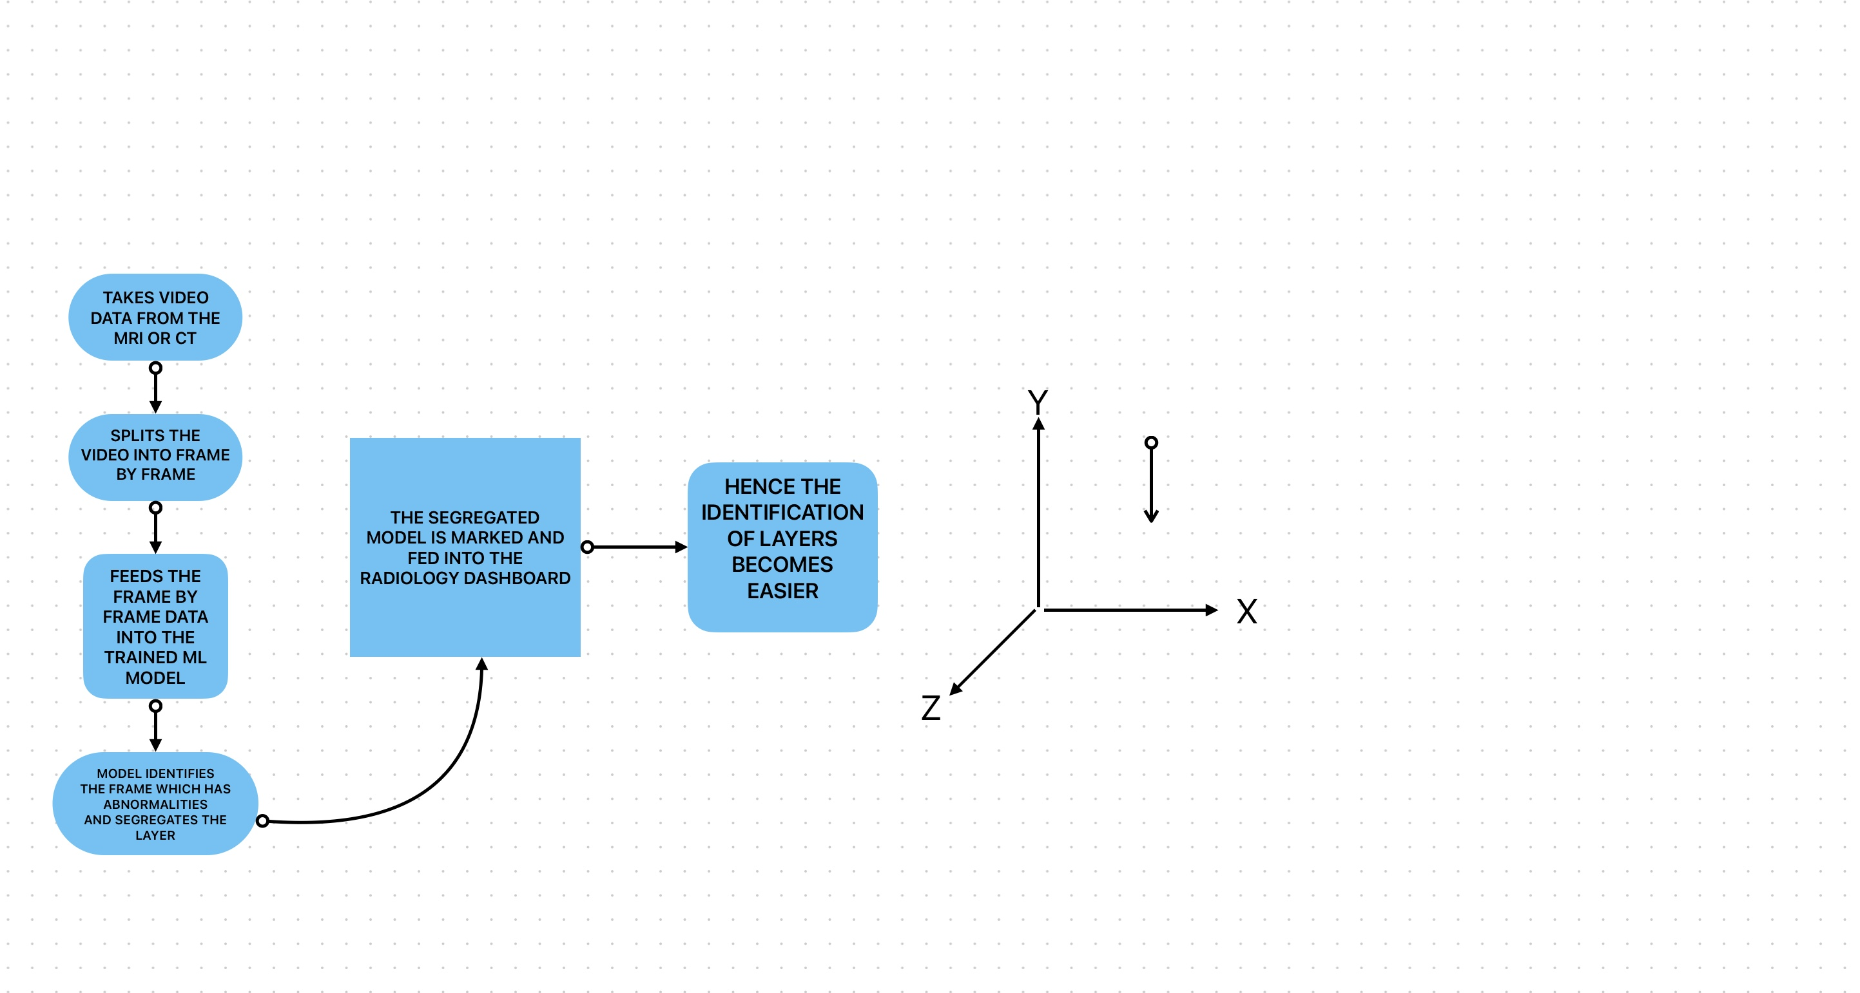
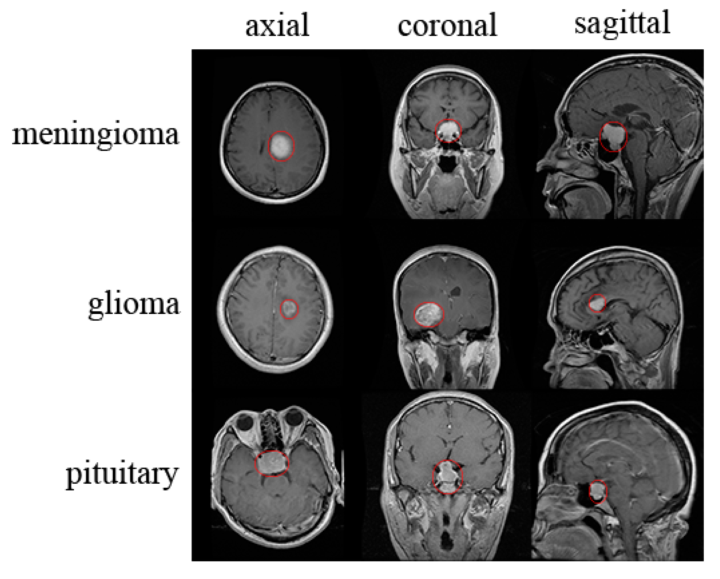
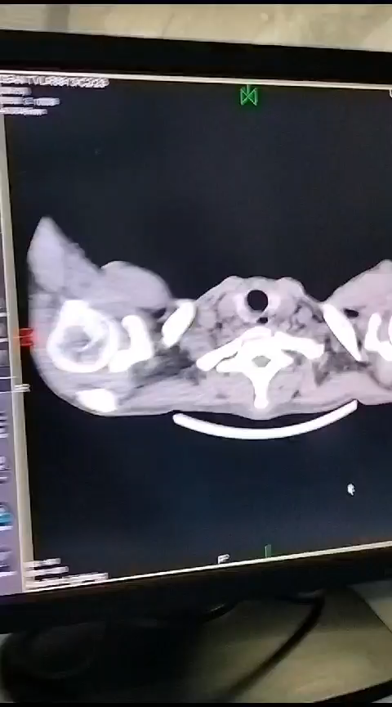
Machine language model for image processing

Slide 5
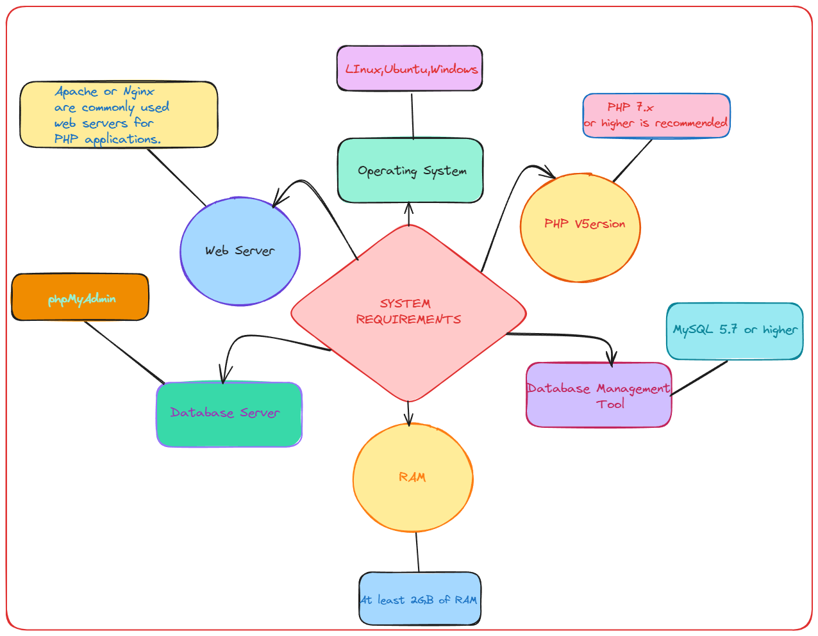
000webhost

Slide 6
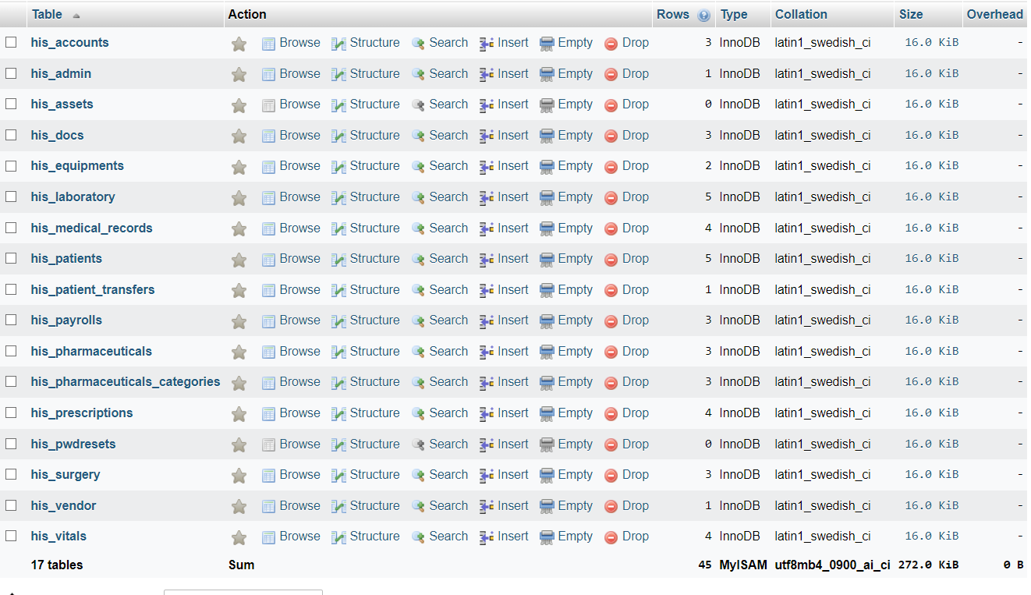
Database Design php My admin:
Designing the database for a Hospital Management System (HMS) using PHP and MySQL is a critical step to ensure efficient data management. Here is a simplified example of a database design for an HMS. Please note that this is a basic schema, and in a real-world scenario, it would be much more complex to accommodate all necessary functionalities and relationships.

Slide 7
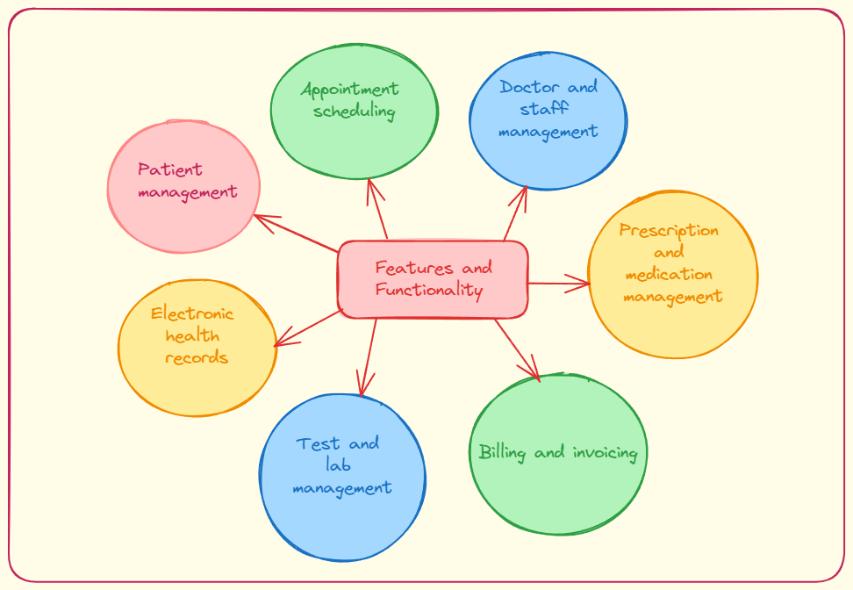

Slide 8
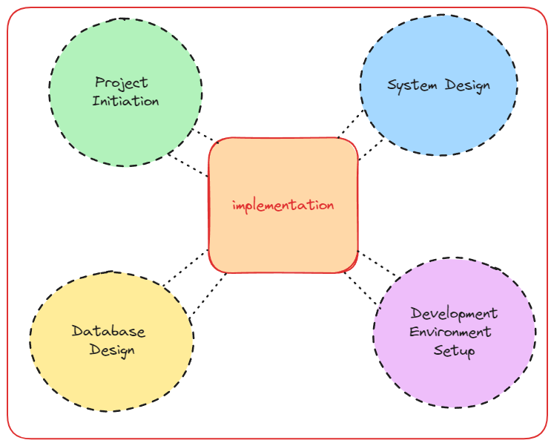

Slide 9
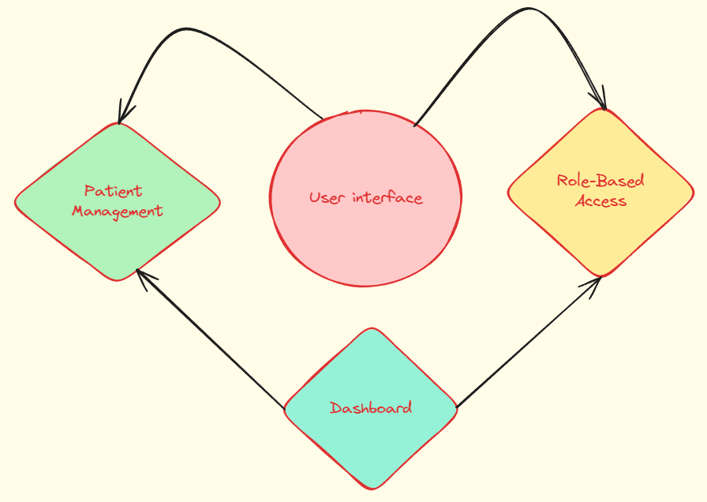

Slide 10
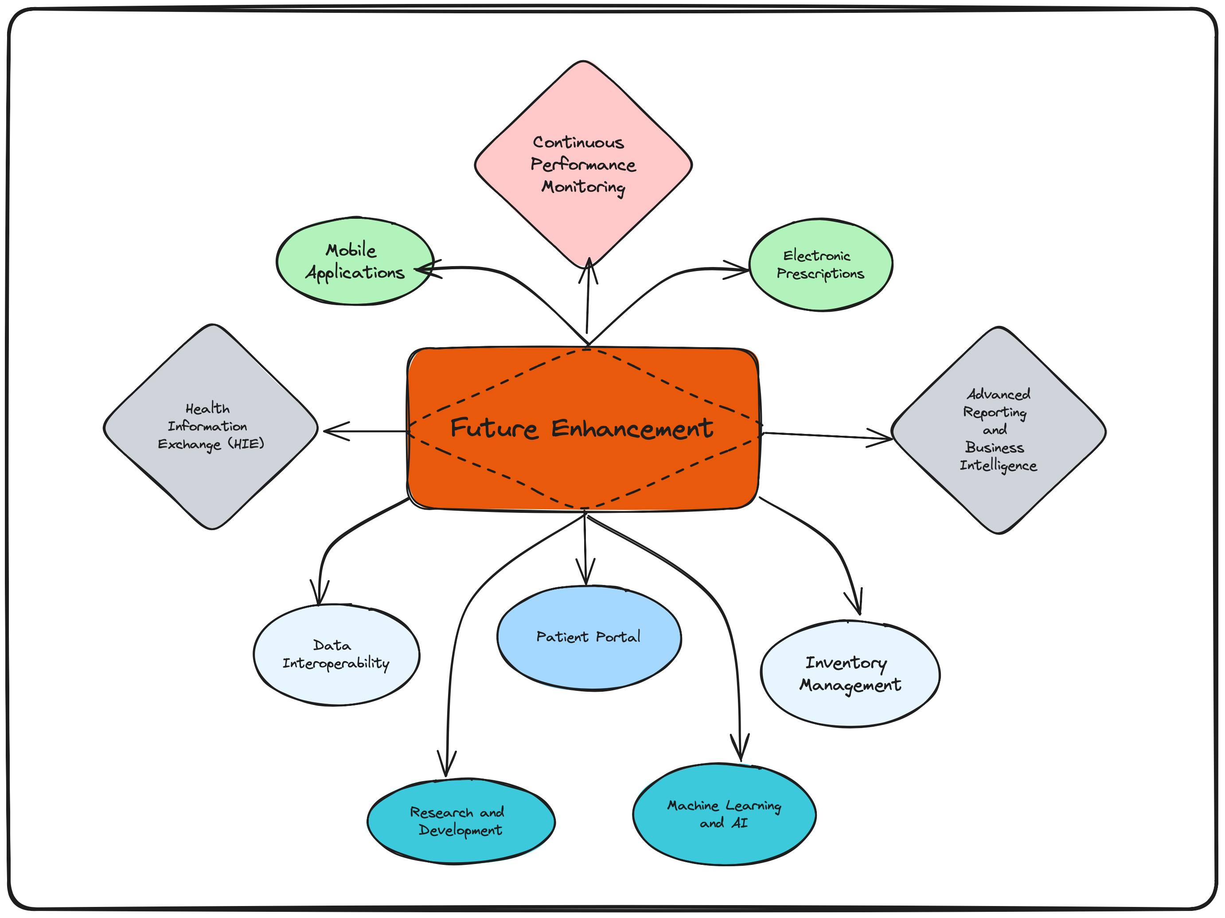

Slide 11
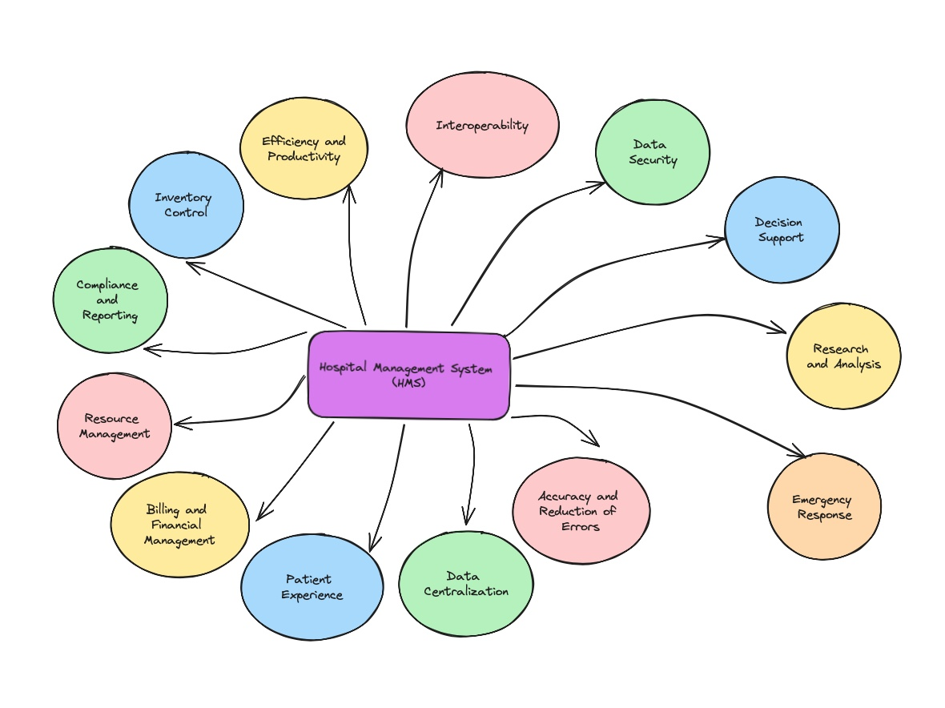
Conclusion:

Slide 12
Thank you

